Slide 1
UNIT III: SUFFICIENCY

Slide 2
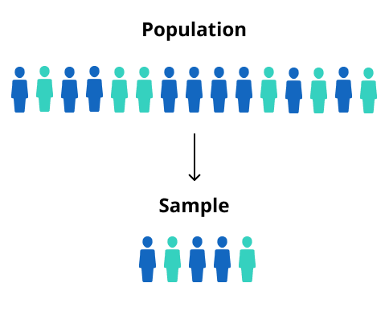
What is a Sufficient Statistic?
A sufficient statistic is a statistic that summarizes all of the information in a sample about a chosen parameter.
For example, the sample mean, x̄ , estimates the population mean, μ. x̄ is a sufficient statistic if it retains all of the information about the population mean that was contained in the original data points.

Slide 3
According to statistician Ronald Fisher,
“…no other statistic that can be calculated from the same sample provides any additional information as to the value of the parameter.”
In layman’s terms, a sufficient statistic is your best bet for summarizing your data; You can use it even if you don’t know any of the actual values in the sample.

Slide 4
Sufficient Statistic Example
You can think of a sufficient statistic as an estimator that allows you to estimate the population parameter as well as if you knew all of the data in all possible samples.
For example, let’s say you have the simple data set 1,2,3,4,5. You would calculate the sample mean as (1 + 2 + 3 + 4 + 5) / 5 = 3, which gives you the estimate of the population mean as 3. Let’s assume you don’t know those values (1, 2, 3, 4, 5), but you only know that the sample mean is 3. You would also estimate the population mean as 3, which would be just as good as knowing the whole data set. The sample mean of 3 is a sufficient statistic. To put this another way, if you have the sample mean, then knowing all of the data items makes no difference in how good your estimate is: it’s already “the best”.
Order statistics for iid samples are also sufficient statistics. This does not hold for data that isn’t iid because only in these samples, can you re-order the data without losing meaning.

Slide 5
Sufficient Statistic Example
When collecting data, the sufficiency principle justifies ignoring certain pieces of information (Steel, 2007). For example, let’s say you were conducting an experiment recording the number of heads in a coin toss.
You could record the number of heads and tails, along with their order: HTTHTTTHHH…. Or, you could just record the number of heads (e.g. 25 heads). For the purposes of a binomial experiment, the number of heads would be a sufficient statistic. Recording all of the tails, and their order, would give you no more information (assuming the variables are independent and identically distributed).

Slide 6
In the process of estimating such a parameter, we summarize, or reduce, the information in a sample of size n, X₁, X₂, ..., X_{n}, to a single number, such as the sample mean
The actual sample values are no longer is, important to us. That if we use a sample mean of 3 to estimate the population mean μ, it doesn't matter if the original data values were (1, 3, 5) or (2, 3, 4).

Slide 7
Definition of Sufficiency
Let X₁, X₂, ..., X_{n} be a random sample from a probability distribution with unknown parameter θ. Then, the statistic Y is said to be sufficient for θ if the conditional distribution of X₁, X₂, ..., X_{n}, given the statistic Y, does not depend on the parameter θ.

Slide 8
PROBLEMS
EXAMPLE
Let X1, X2, ..., Xn be a random sample of n Bernoulli trials in which:
Xi = 1 if the ith subject likes Pepsi
Xi = 0 if the ith subject does not like Pepsi
If p is the probability that subject i likes Pepsi, for i = 1, 2, ..., n, then:
Xi = 1 with probability p
Xi = 0 with probability q = 1 – p
Suppose, in a random sample of n = 40 people, that people like Pepsi. If we know the value of Y, the number of successes in n trials, can we gain any further information about the parameter p by considering other functions of the data X1, X2, ..., Xn? That is, is Y sufficient for p?

Slide 9
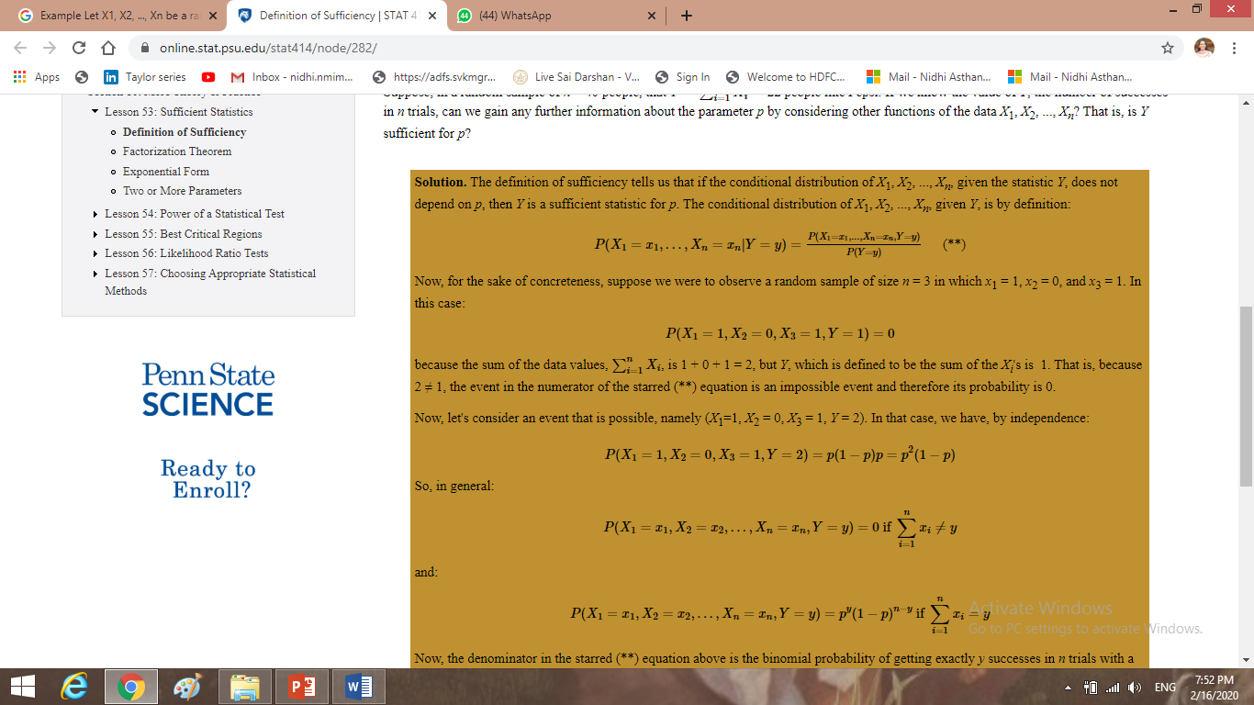

Slide 10
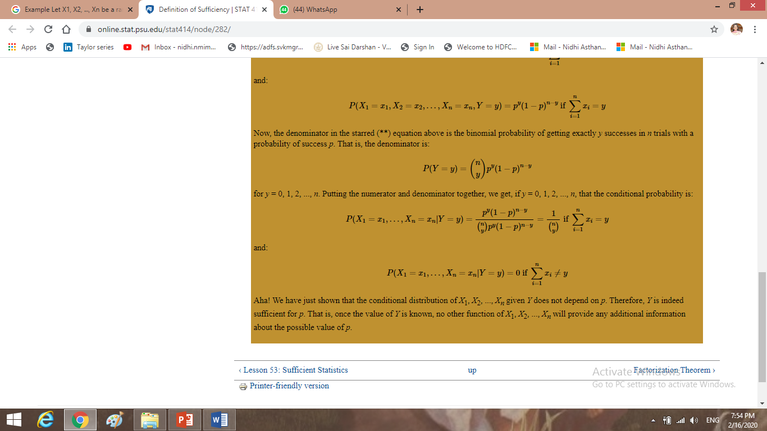

Slide 11
PROBLEMS
Example: Toss a coin n times, and the probability of head is an unknown parameter θ. Let T = the total number of heads. Is T sufficient for θ?

Slide 12
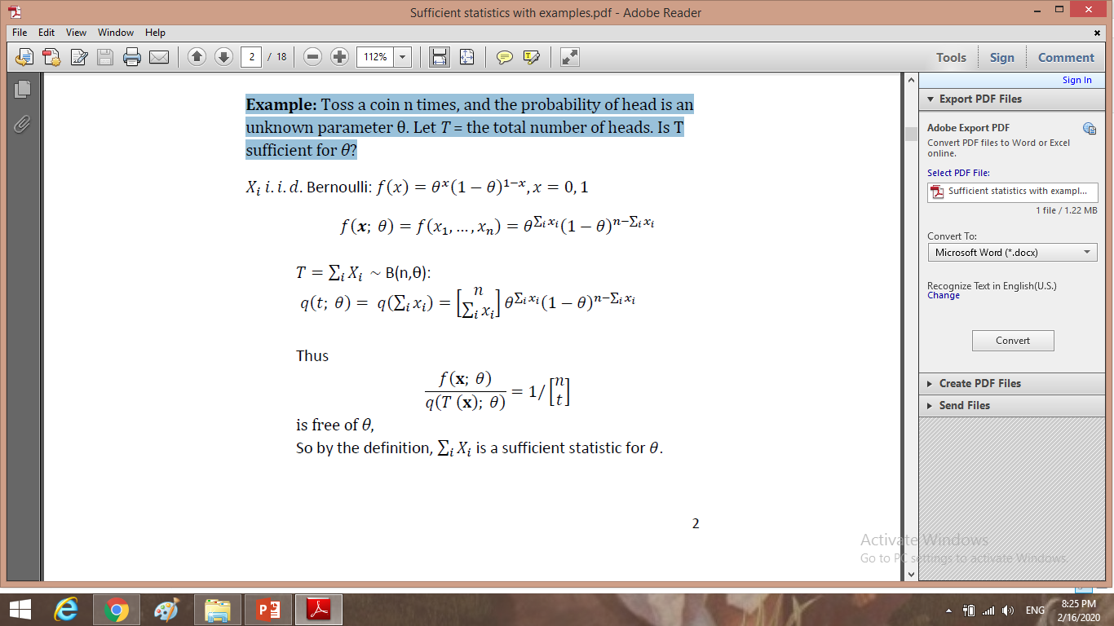

Slide 13
It is not always all that easy to find the conditional distribution of X₁, X₂, ..., X_{n} given Y.
Therefore, using the formal definition of sufficiency as a way of identifying a sufficient statistic for a parameter θ can be a difficult task. Factorization Theorem provides an easier alternative.

Slide 14
Factorization Theorem
Factorization Theorem. Let X₁, X₂, ..., X_{n} denote random variables with joint probability density function or joint probability mass function f(x₁, x₂, ..., x_{n}; θ), which depends on the parameter θ.
Then, the statistic Y=u(X₁,X₂,...,X_{n})Y=u(X₁,X₂,...,X_{n}) is sufficient for θ if and only if the p.d.f (or p.m.f.) can be factored into two components, that is:
f(x₁,x₂,...,x_{n};θ)=ϕ[u(x₁,x₂,...,x_{n});θ]h(x₁,x₂,..., x_{n})
where:
φ is a function that depends on the data x₁, x₂, ..., x_{n} only through the function u(x₁, x₂,..., x_{n}), and the function h(x₁, x₂, ..., x_{n}) does not depend on the parameter θ.

Slide 15
PROBLEMS
Example
Let X₁, X₂, ..., X_{n} denote a random sample from a Poisson distribution with parameter λ > 0. Find a sufficient statistic for the parameter λ.

Slide 16


Slide 17
PROBLEMS
Example: Normal
Let X₁, X₂, ..., X_{n} be a random sample from a normal distribution with mean μ and variance 1. Find a sufficient statistic for the parameter μ.

Slide 18
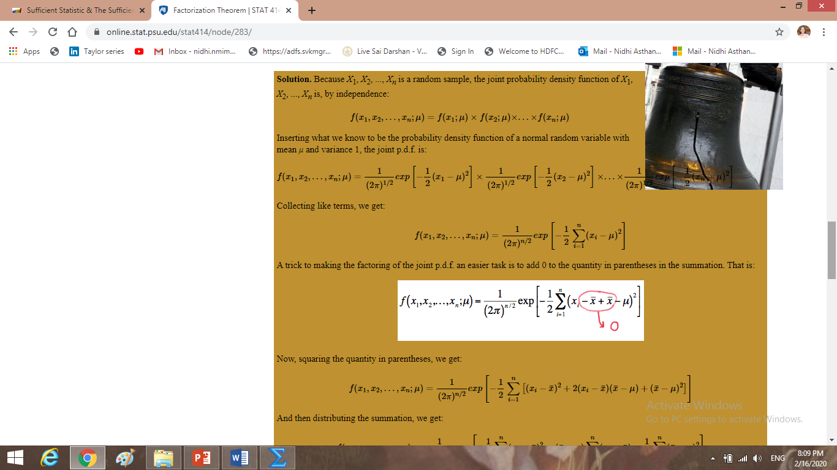

Slide 19
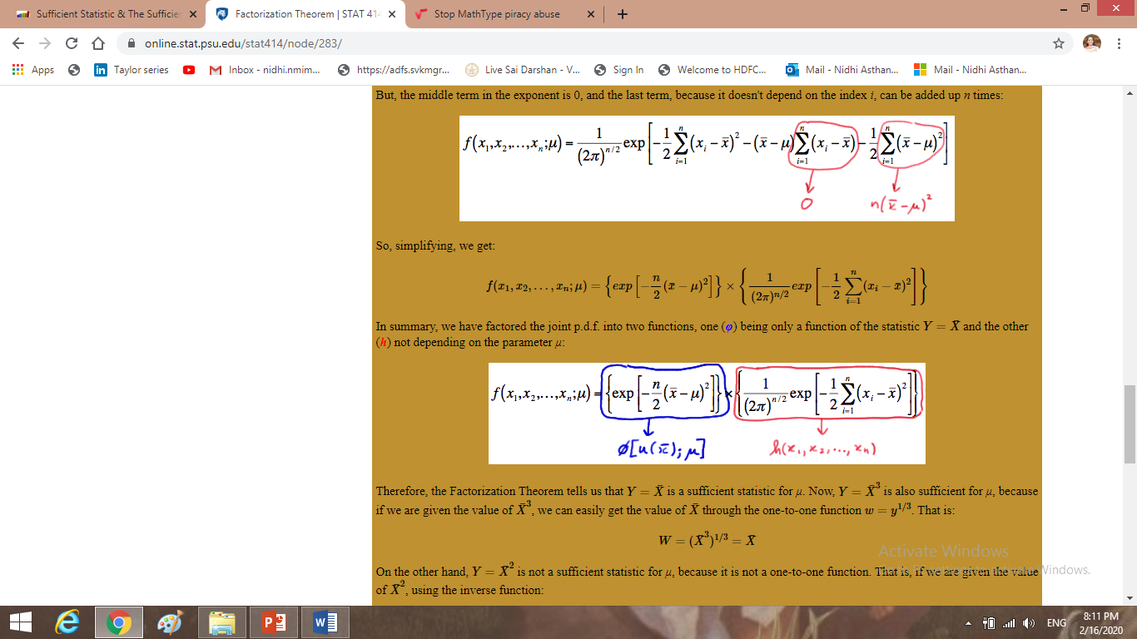

Slide 20
PROBLEMS
Example
Let X₁, X₂, ..., X_{n} be a random sample from an exponential distribution with parameter θ. Find a sufficient statistic for the parameter θ

Slide 21
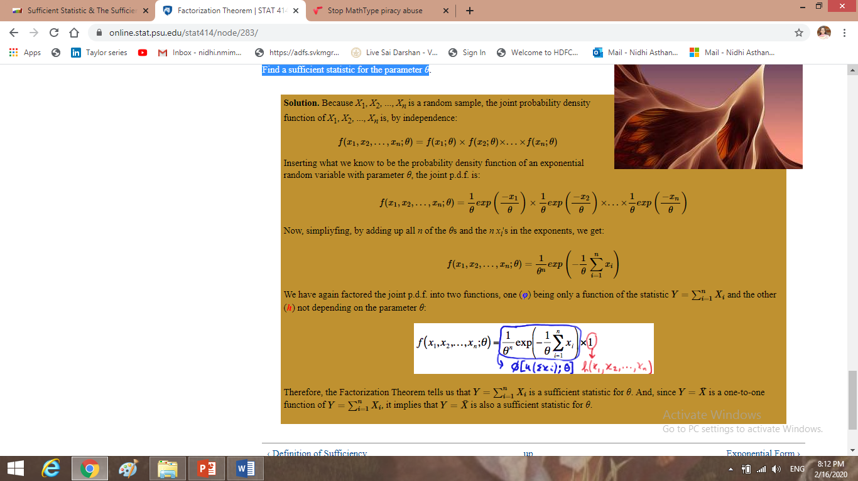

Slide 22
Two or More Parameters
In each of the examples we considered so far in this lesson, there is one and only one parameter. What happens if a probability distribution has two parameters, θ₁ and θ₂, say, for which we want to find sufficient statistics, Y₁ and Y₂? Fortunately, the definitions of sufficiency can easily be extended to accommodate two (or more) parameters. Let's start by extending the Factorization Theorem

Slide 23
Definition (Factorization Theorem). Let X₁, X₂, ..., X_{n} denote random variables with a joint p.d.f. (or joint p.m.f.):
f(x₁,x₂,...,x_{n};θ₁,θ₂)
which depends on the parameters θ₁ and θ₂. Then, the statistics Y₁=u₁(X₁,X₂,...,X_{n}) and Y₂=u₂(X₁,X₂,...,X_{n}) are joint sufficient statistics for θ1 and θ2 if and only if:
f(x₁,x₂,...,x_{n};θ₁,θ₂)=ϕ[u₁(x₁,...,x_{n}),u₂(x₁,...,x_{n});θ₁,θ₂]h(x₁,...,x_{n})
where:
ϕ is a function that depends on the data (x₁,x₂,...,x_{n}) only through the functions u₁(x₁,x₂,...,x_{n}) and u₂(x₁,x₂,...,x_{n}), and the function h(x₁,...,x_{n}) does not depend on either of the parameters θ₁ or θ₂.

Slide 24
PROBLEMS
Example
Let X₁, X₂,..., X_{n} denote a random sample from a normal distribution N(θ₁, θ₂). That is, θ₁ denotes the mean μ and θ₂ denotes the variance σ₂. Use the Factorization Theorem to find joint sufficient statistics for θ₁ and θ₂.

Slide 25
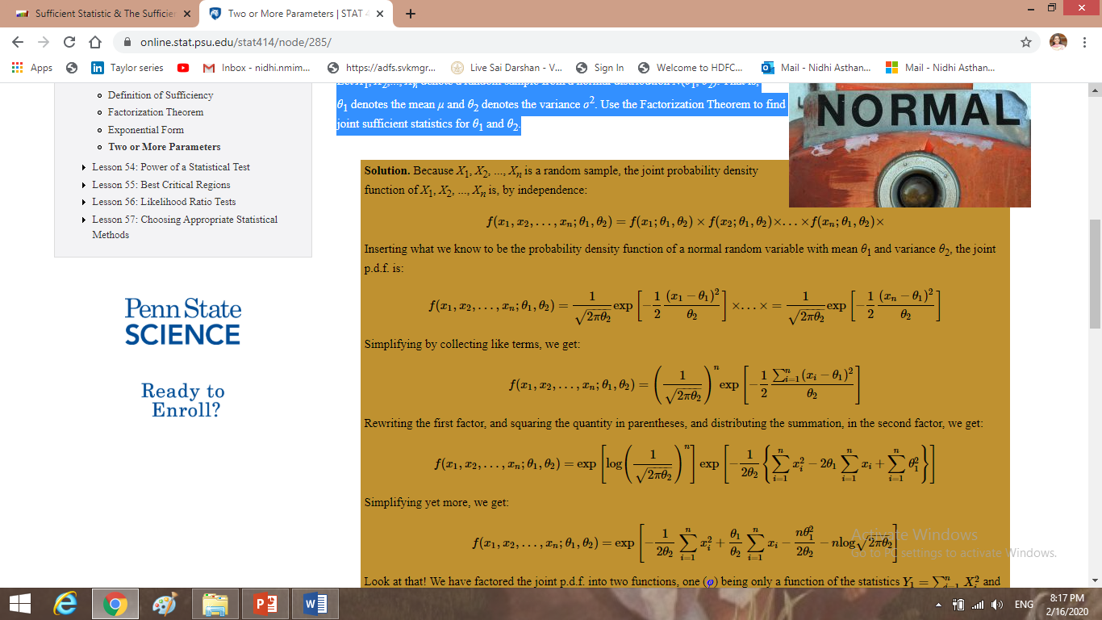

Slide 26
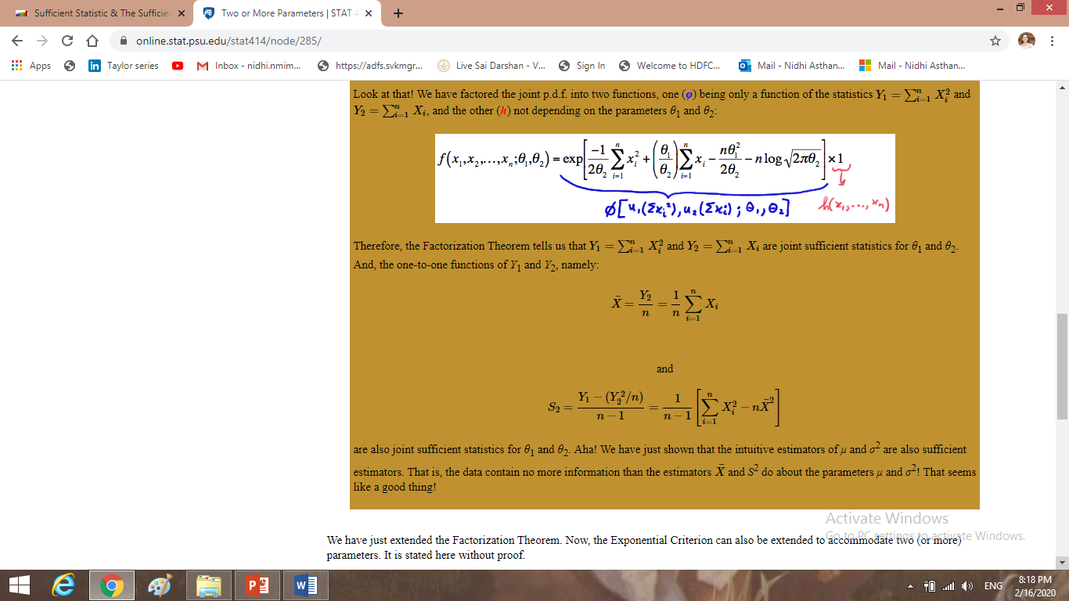

Slide 27
Exponential Criterion.
Let X₁, X₂, ..., X_{n} be a random sample from a distribution with a p.d.f. or p.m.f. of the exponential form:
f(x;θ₁,θ₂)=exp[K₁(x)p₁(θ₁,θ₂)+K₂(x)p₂(θ₁,θ₂)+S(x)+q(θ₁,θ₂)]
with a support that does not depend on the parameters θ₁ and θ₂. Then, the statistics Y₁=∑ni=1K₁(Xi) and Y2=∑n_{i}=1K₂(X_{i}) are jointly sufficient for θ1 and θ2.

Slide 28
PROBLEMS
Example (continued)
Let X₁, X₂,..., X_{n} denote a random sample from a normal distribution N(θ₁, θ₂). That is, θ₁ denotes the mean μ and θ₂ denotes the variance σ₂. Use the Exponential Criterion to find joint sufficient statistics for θ₁ and θ₂.

Slide 29
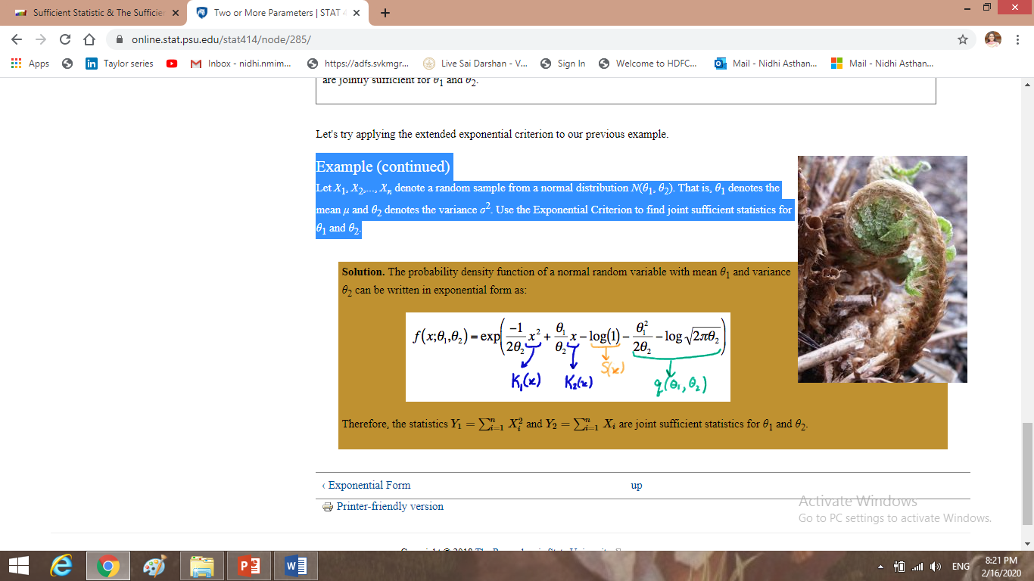

Slide 30


